Slide 1
Inequality, mobility and classes
Rafael Marques

Slide 2
Inequality and Stratification

Slide 3
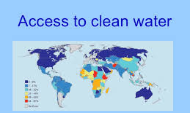
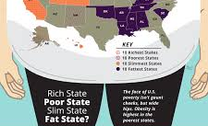
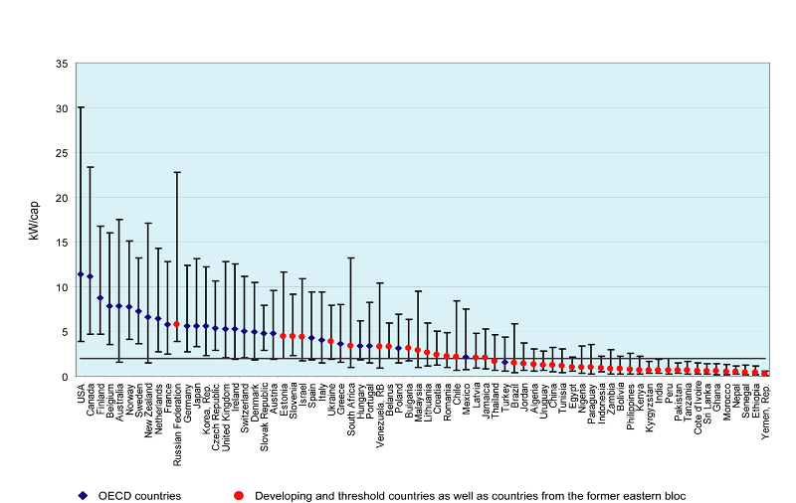
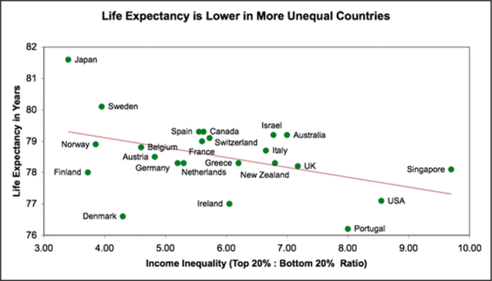
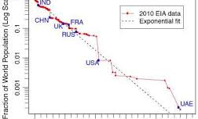
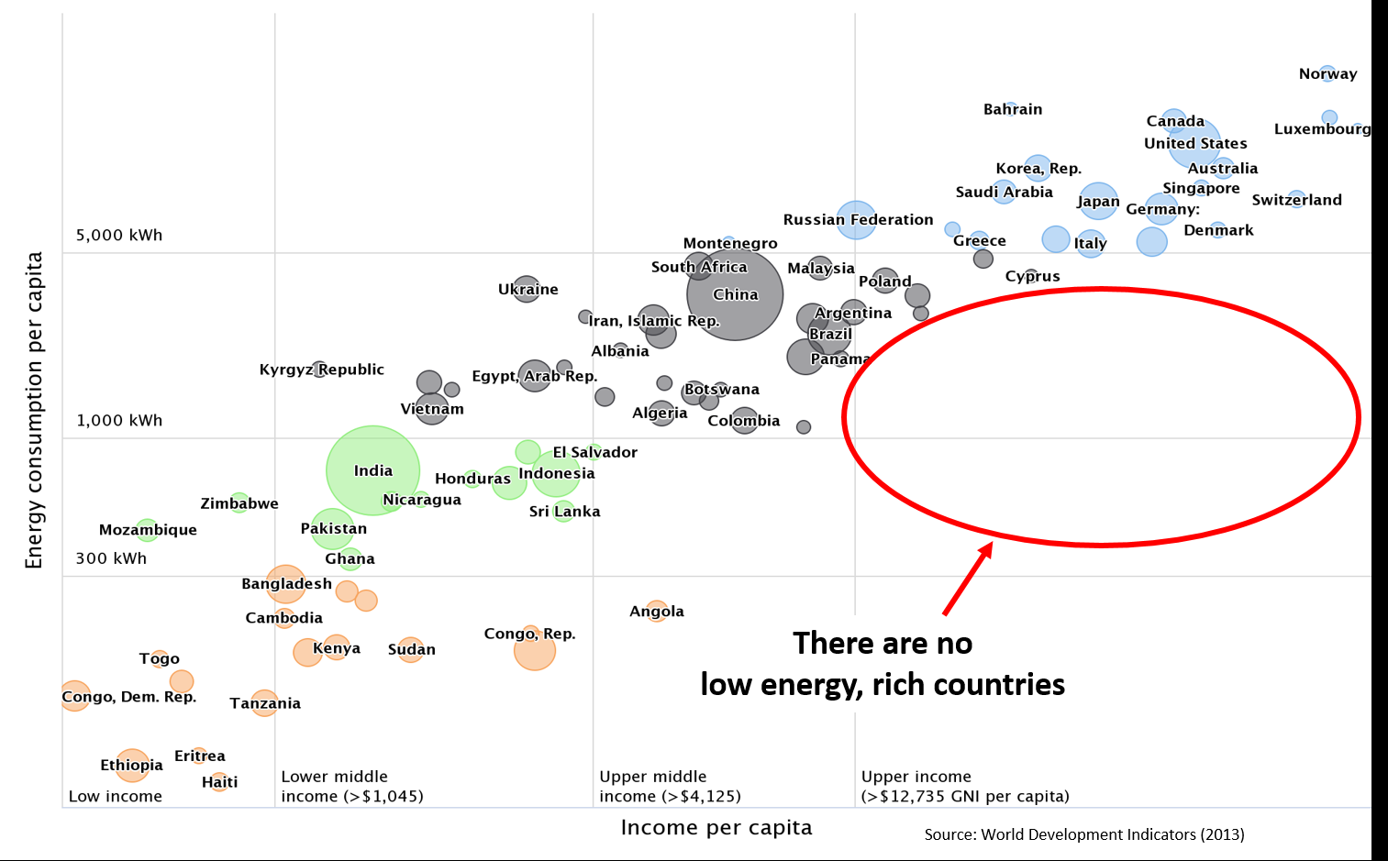
Inequalities
There are multiple dimensions that can be explored to identify inequalities both in micro and macro terms.
Think about other indicators that you consider relevant.

Slide 4
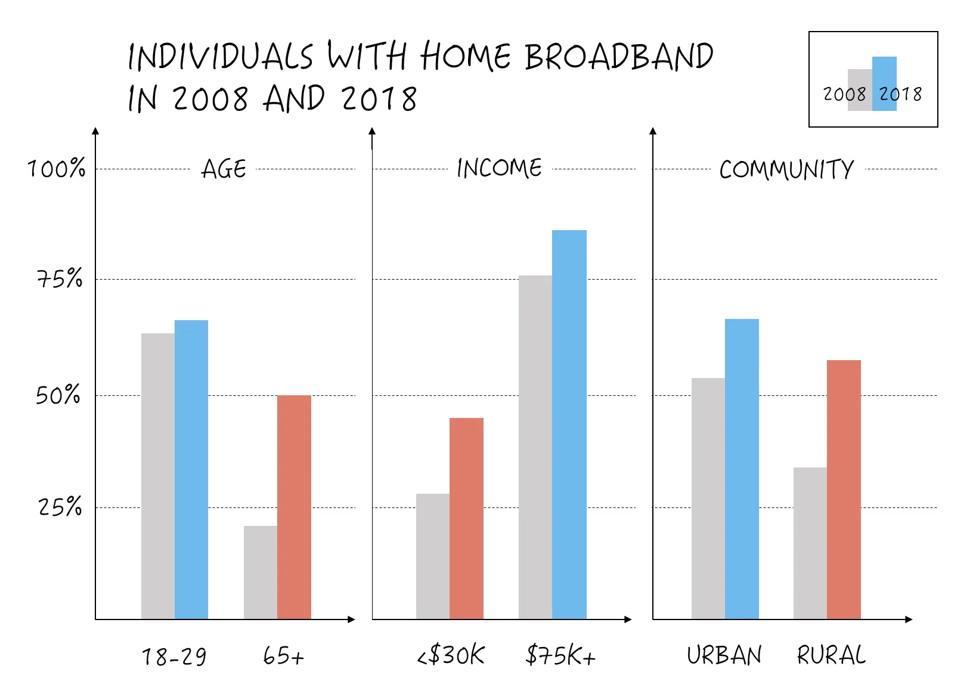
Some Types

Slide 6
Income Inequality

Slide 7
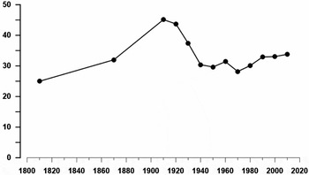
The One Percent

Slide 8
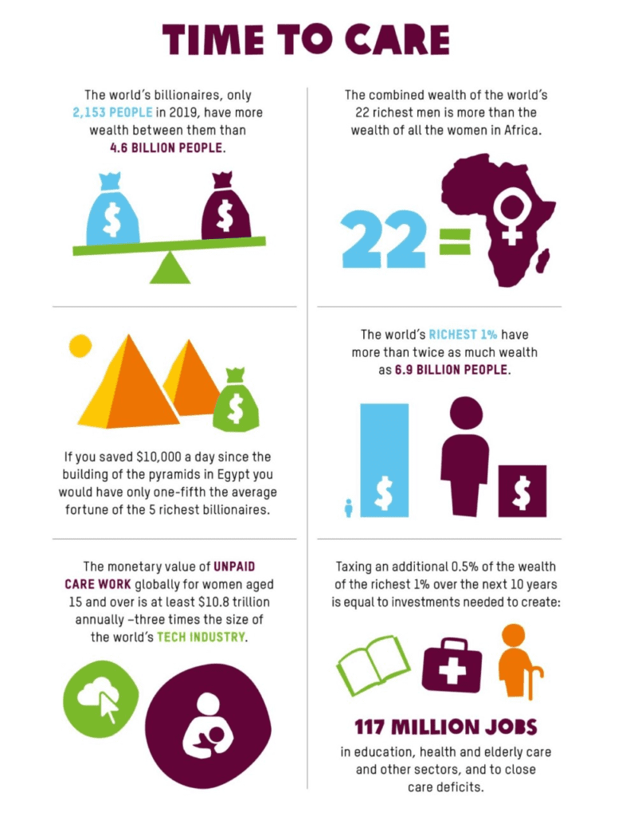
Global Stratification

Slide 9
Poverty and Population Growth

Slide 11
Systems of Stratification

Slide 12
Slavery

Slide 13
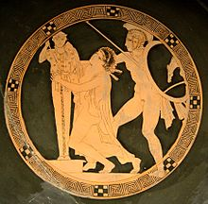
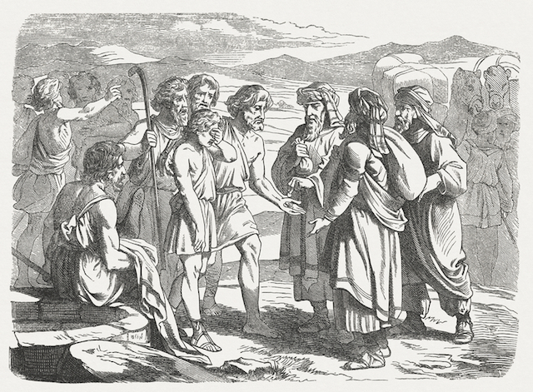
Ancient World and Slavery

Slide 14
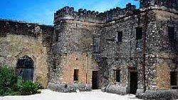
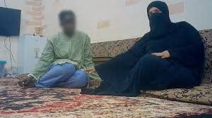
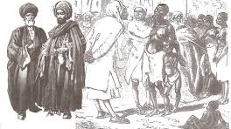
Arab Slave Trade

Slide 15
Slavery
Atlantic Slave Trade: The enterprise through which African slaves were brought to work on plantations in the Caribbean Islands, Latin America, and the southern United States primarily.
Bonded labor: A form of indenture in which a loan is repaid by work, the worker being unable to leave until the debt is repaid
Slavery: an institution or social practice of owning human beings as property, especially for use as forced laborers
Debt bondage: A condition similar to slavery where human beings are unable to control their lives or their work due to unpaid debts.

Slide 16
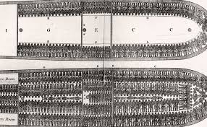
Living Conditions

Slide 17
Modern Slave Trade
Slavery is a system of social stratification that has been institutionally supported in many societies around the world throughout history.
The Atlantic slave trade brought African slaves to the Americas from the 1600’s to the 1900’s, spurring the growth of slave use on plantations in the U.S., where the slave population reached 4 million before slavery was made illegal in 1863.
Human trafficking, or the illegal trade of humans, is primarily used for forcing women and children into sex industries.

Slide 18
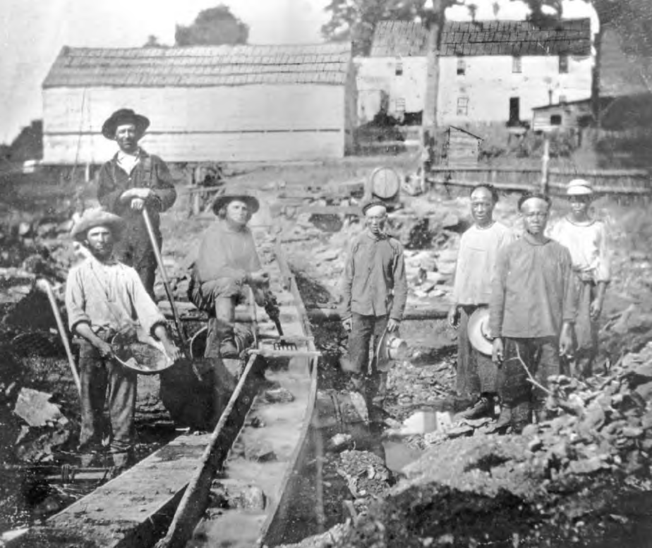
Coolies and Indented Labour

Slide 19
Girmitiya System
Girmitiya or Jahajis were indentured Indian labourers whom the British Empire sent to Fiji, Mauritius, South Africa, and the Caribbean (mostly Trinidad and Tobago, Guyana, Suriname, and Jamaica) to work on sugarcane plantations for the benefit of European settlers. (In Fiji, policy discouraged Melanesian Fijians from working on these plantations, in an attempt to preserve their culture.)

Slide 20
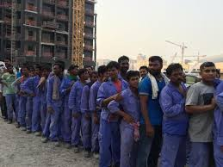
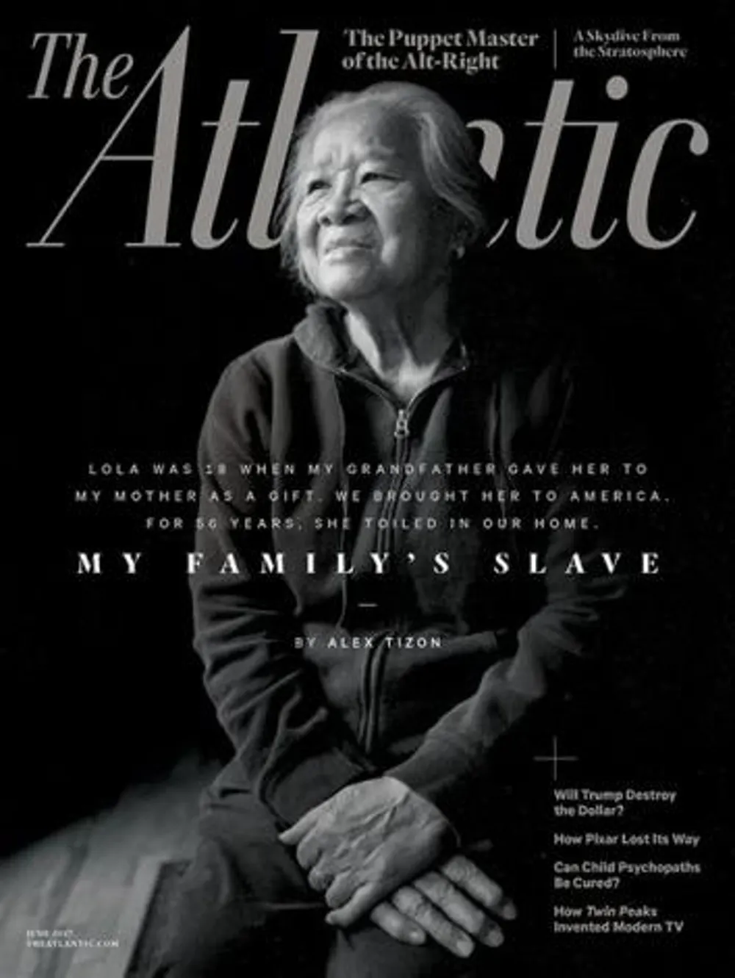
Modern Indented Labour

Slide 21
Definition of castes
Social stratification based on ascription or birth
Differences to classes:
Closed class system with life time status
No possibility of social mobility
No inter-caste marriage
Based on cultural beliefs and religion

Slide 22
Castes in the past and today
UK:
Past: caste like aristocracy
→Leading clergy, nobility, commoners
Today: Class system mixes caste and meritocracy
→More emphasis on labour, money and education

Slide 23
Castes in the past and today
Japan
Past: rigid caste system
Imperial family ruled over nobles and commoners
Today: operating monarchy and modern society
→importance of family background and traditional gender rules

Slide 24
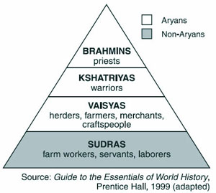
Castes in the past and today
Hindu caste system
Formally outlawed
Rural India: traditional
caste system
Cities: class system

Slide 25
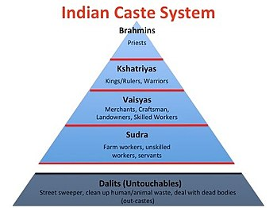
Castes

Slide 26
Almost Caste
Colonial Mexican Caste System: After the Spanish colonized Mexico, one’s position in a caste system depended on how European or indigenous one seemed. Both biological and sociocultural indicators were used to measure ethnicity.

Slide 27
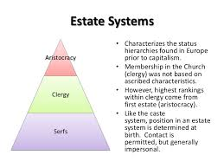

Slide 28
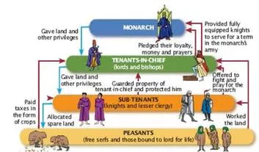
The Feudal Order

Slide 29
Feudal Japan

Slide 30
Definition of classes
Social stratification based on birth and individual achievement
Status hierarchy
Classification on the basis of esteem and prestige
Acquirement through economic success and accumulation of wealth

Slide 31
Classes in the past centuries
1. Karl Marx: two great classes
owners of the means of production
workers → “labour power”
2. Industrial society (1960)
Upper class, middle class, working class

Slide 32
Classes in today’s societies
America
Upper class
Middle class
Working class
Lower class

Slide 33
Classes in the U.S. today
1. Upper Class – Elite (> $200,000)
Upper-upper class (old-rich)
Upper-lower class (new-rich)
2. Middle Class
Upper middle class ($112,500 to $200,000)
Lower middle class (around $60,000)

Slide 34
Classes in the U.S. today
3. Working Class ($27,000 to $48,000)
blue-collar workers
4. Lower Class (< $27,000)
wages below the poverty line
→ lack of financial security
Similar class systems in Western Europe and Japan

Slide 35
Reasons for classification
Differences in…
Income and wealth
Ancestry
Education system
Authority levels
Housing situations
Race and ethnicity

Slide 36
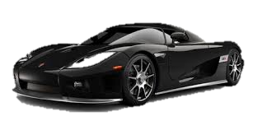
Influences of classes in society
Health
Values and Attitudes
Politics
Family and Gender

Slide 37
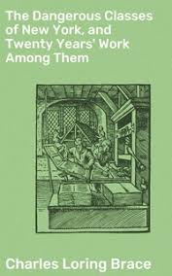
The Dangerous Classes: Yesterday and Today

Slide 38
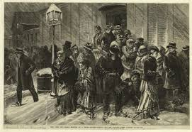
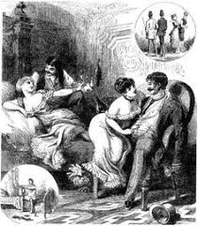
Threats and Dangers

Slide 39
The Dangerous Classes
A term taken from the title of the book (The Dangerous Classes of New York) published in 1872 by the American social reformer Charles Loring Brace. His ‘dangerous classes’ included the vagabonds, waifs, predatory criminals, vagrants, and prostitutes that emerged out of the poor underclass in late nineteenth-century New York city. Sociologists and criminologists have sometimes argued that contemporary policing policies (for example in relation to drugs control) are still informed by this concept, and contain a hidden agenda which aims either to identify ‘public enemies’ who can be blamed for various economic and social problems, or to suppress members of today's ‘dangerous classes’ (immigrants, youths, various minority groups) in the interests of public order and security (see, for example, Diana Gordon , The Return of the Dangerous Classes, 1994)

Slide 40
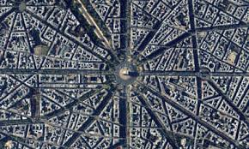
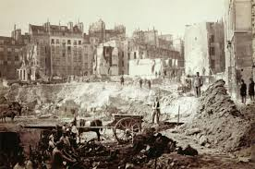
Urban Reform – Baron Haussmann

Slide 41
Marx and Social Class

Slide 42
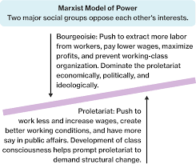
Power and Conflict at the Macro-Level
PR = SV/FC+VC
SV ?
VC ?
VC and FC

Slide 43
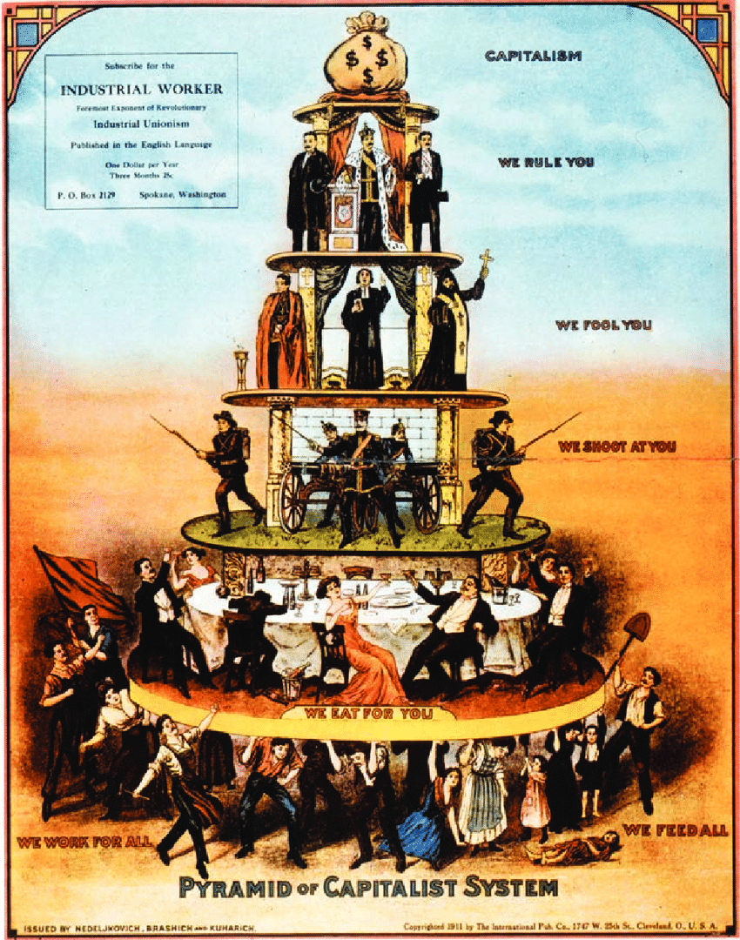
Class Struggles

Slide 44
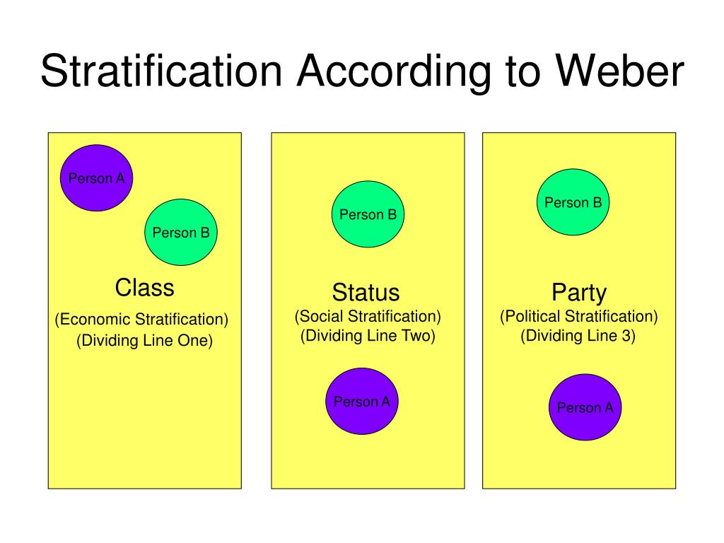
Weber’s Model

Slide 45
Weber’s Model

Slide 46
Status Groups

Slide 47
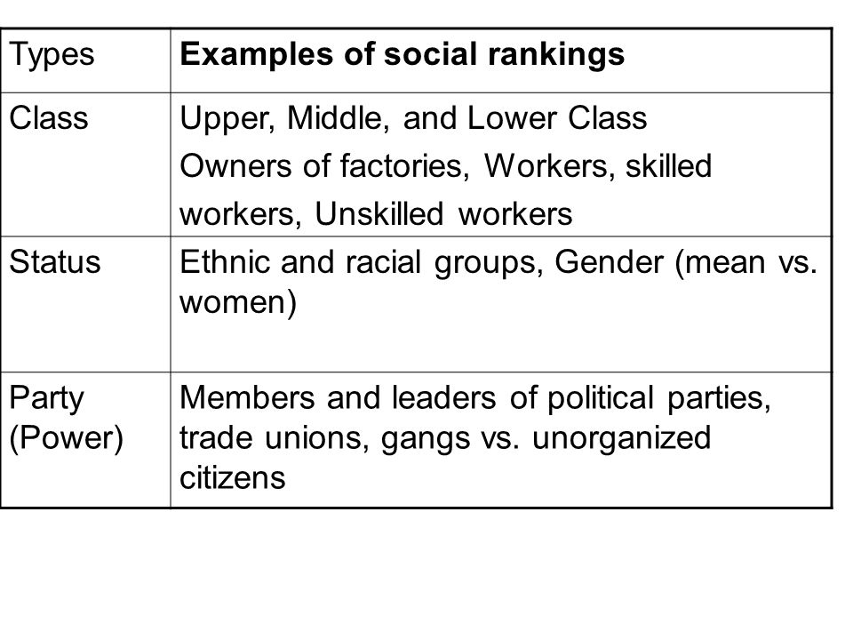
Max Weber’s View

Slide 48
A Functionalist View

Slide 49
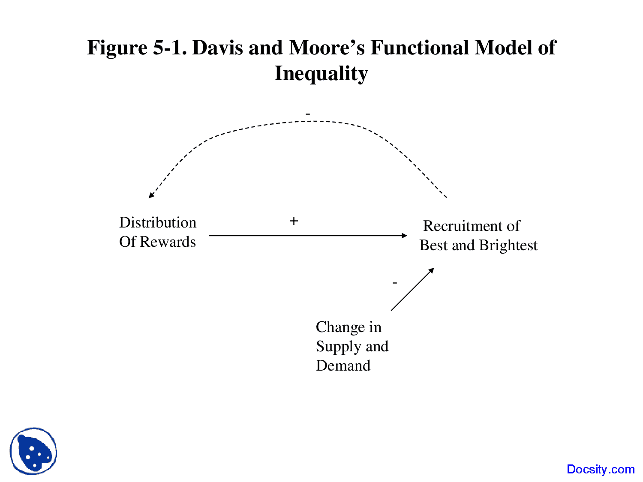
Davis and Moore Model

Slide 50
Criticism

Slide 51
Bourdieu’s Contribution

Slide 52
Bourdieu

Slide 53
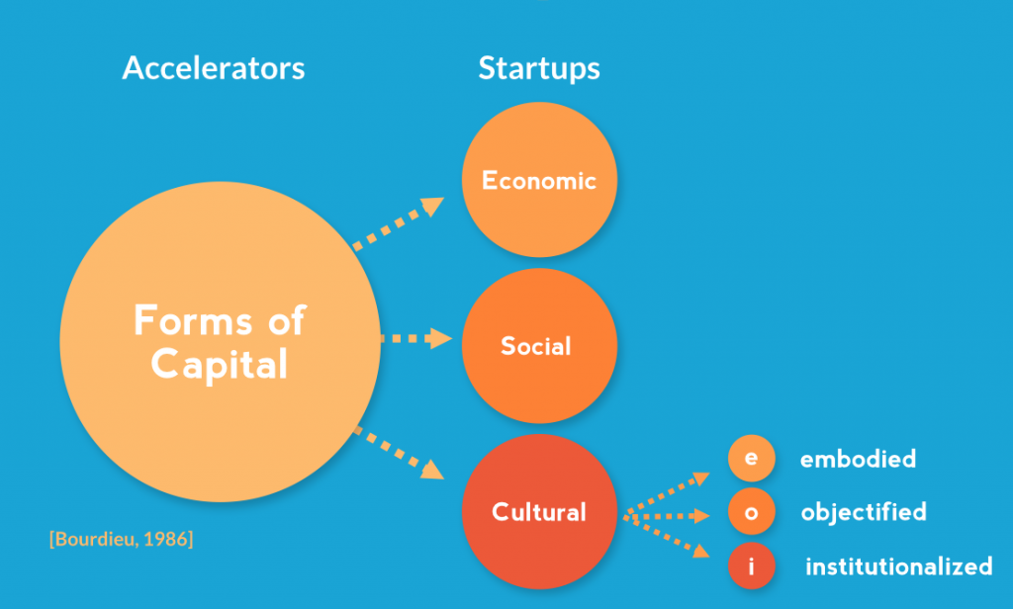
Bourdieu’s Model

